Slide 1
Data storytelling
Data storytelling is the ability to tell a story with data and to personalize that data based on the audience its going to be presented to.
What is Data Storytelling ?
Data storytelling is the art of transforming raw data into a compelling narrative that engages and informs your audience .
Data storytelling is an art that requires a combination technical skills and creativity .

Slide 2
The benefits of data storytelling :
Adding value to your data and insights.
Providing a human touch to your data.
Offering value to your audience and industry.
Building credibility as an industry and topic thought leader.

Slide 3
Why is data storytelling important ?
Data storytelling can help the audience understand and remember complex information more easily.
By organizing the data in a logical and visually appealing way and explaining it with clear and concise language
Data storytelling can help the audience grasp the key points and retain the information over time

Slide 4
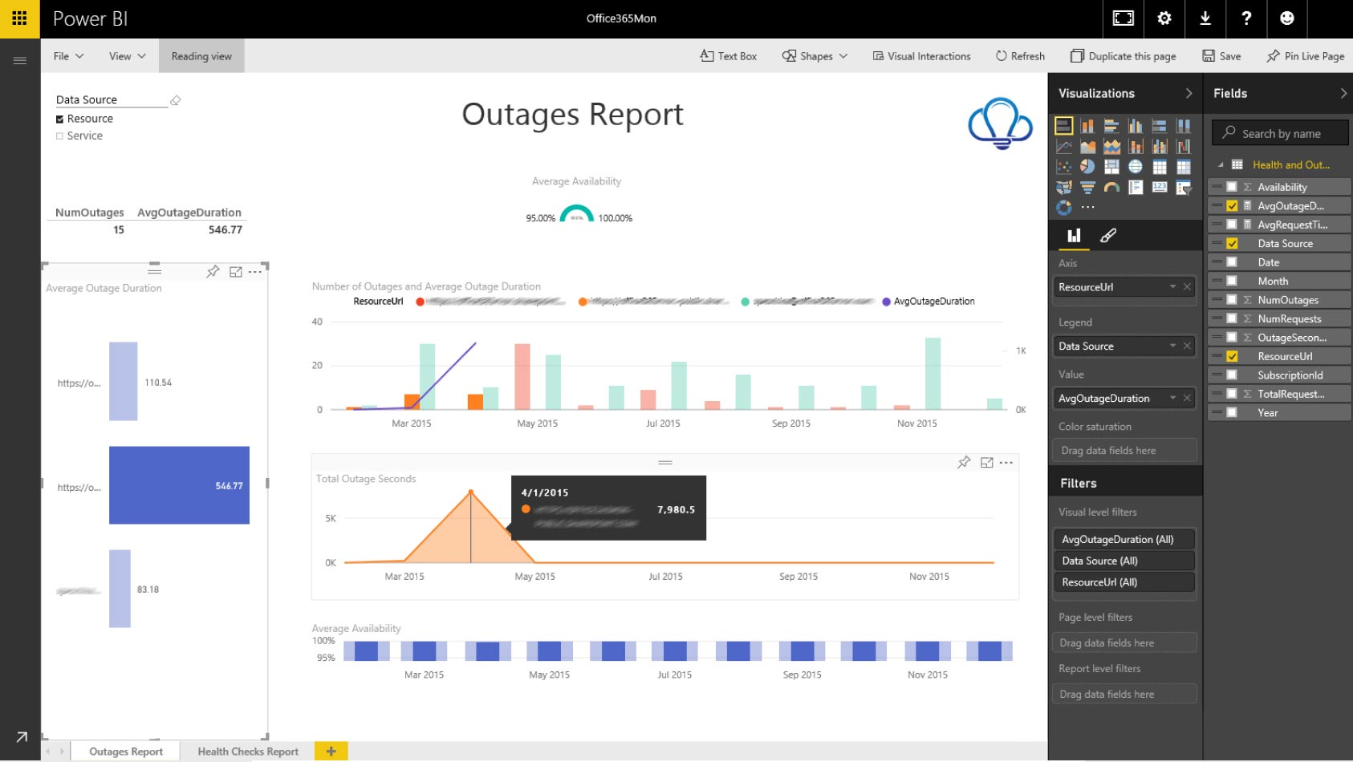
Data storytelling example
Data storytelling is the art of presenting data with a contextual narrative. There are a few different ways to present your data story. A data dashboard presents all available data so you’re able to create your narrative. Below are a examples of eye-catching data storytelling.

Slide 5
Data visualization
Data visualization is the presentation of data in graphical format.
It is transforming complex data into meaningful information
Data visualization is the representation of data through use of common graphics, such as charts, plots, infographics, and even animations
Why data visualization is important ?
Data visualization highlights patterns and trends in data and gives the reader quick insights .
Data visualization are easier to understand than text-based narrative and numbers .

Slide 6
Evaluating data visualization tools
What are your goals and needs?
Take a moment to list out what types of data you have and what kinds of information and insights you want to gather.
What features do you require?
Top data visualization solutions include features like business intelligence, analytics, enterprise reporting capabilities, giving you flexibility to meet your needs both today and tomorrow.
Where will your data come from?
Consider how you’ll connect or import your data and determine if the tool offers a seamless fit with your systems.
Where will you need to see your data?
Find a tool that allows you to take your data and dashboards with you on any device, for quick insight and collaboration anywhere you are.

Slide 7
Data dashboard
Data dashboards are a summary of different, but related data sets, presented in a way that makes the related information easier to understand.
Dashboards are a type of data visualization, and often use common visualization tools such as graphs, charts, and tables.
Benefits of dashboards :
There are many benefits to using dashboards as you visualize and understand data.
Data clarity
Real-time analytics
More accurate forecasting
Increased accessibility and transparency
Better decision-making and problem solving

Slide 8
key performance indicator :
Key performance indicator, a quantifiable measure of performance over time for a specific objective.
A key performance indicator is a measurable value that shows how effectively you’re meeting your goals.
KPIS are an essential part of dashboard architecture
KPI dashboards provide users with:
a fast, easy solution to tracking KPIS and other business metrics.
A unified view of data that improves visibility into company health.
Customizable data visualization with performance and status indicators.

Slide 9
Types of KPI
Quantitative KPIs
Qualitative KPIs
Lagging KPIs
Leading KPIs

Slide 10
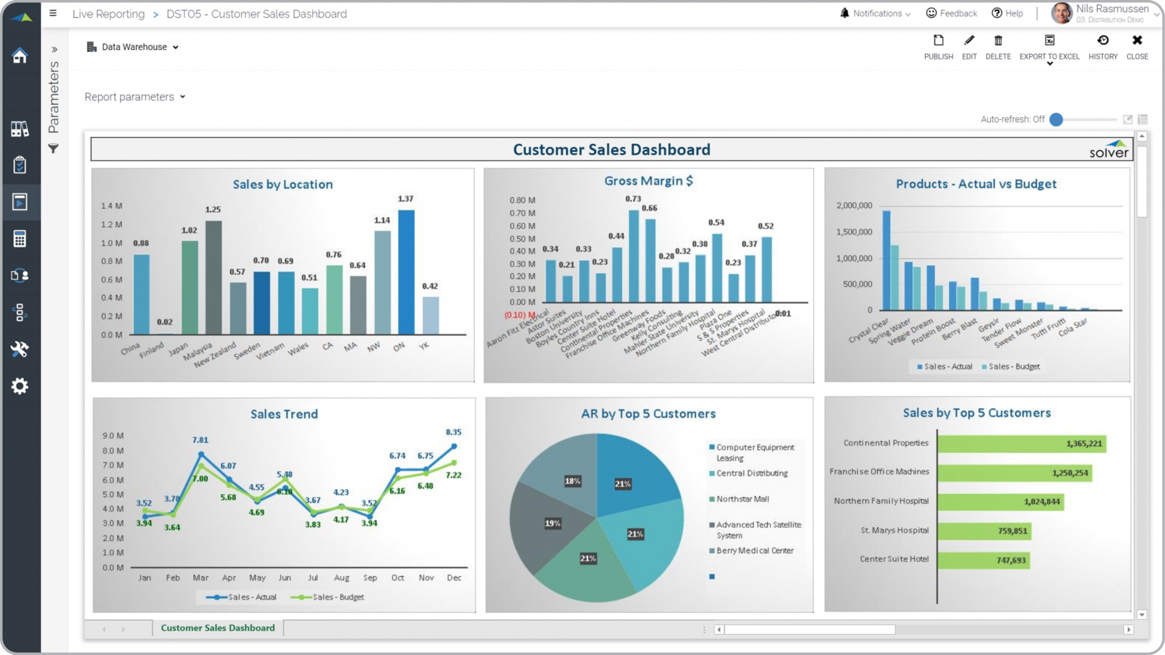
Example of dashboards

Slide 11
Dashboard mistakes to avoid
Not creating A clear goal for the dashboard
Implementing too many KPIS per dashboard
using low-quality data
Representing data in the wrong type of graph or chart
presenting too much information in one dashboard
Using A cluttered, confusing, or inaccessible design

Slide 12
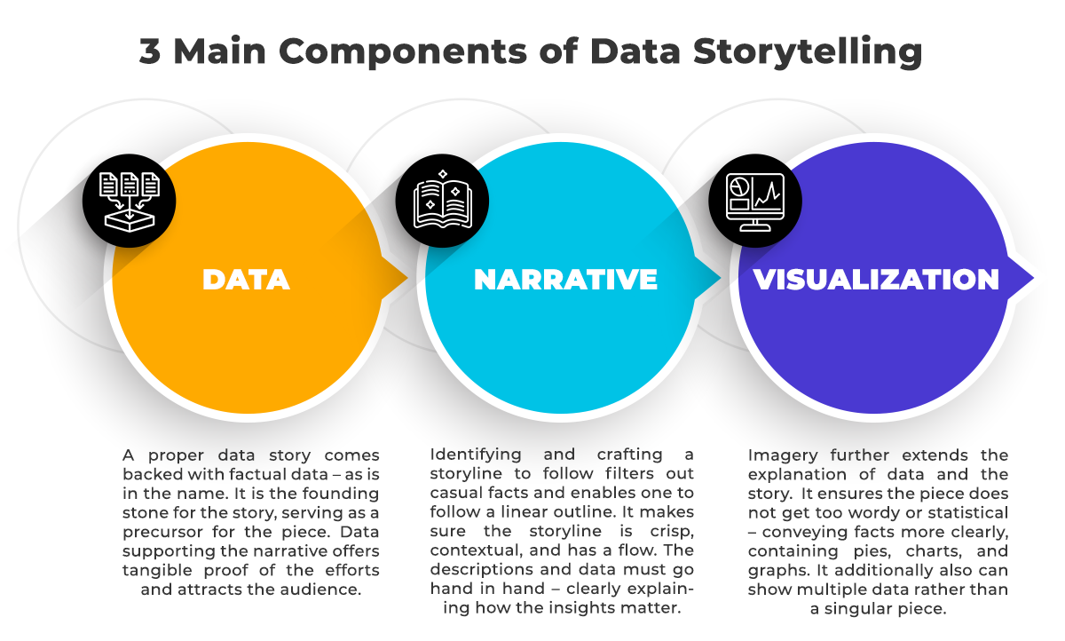
The three key elements of data storytelling

